Slide 1
DEI In Action:
How Research Administrators Can Enact Change, Every Day
Lauren Gee, Department of Medicine
NCURA Region IV Diversity, Equity, and Inclusion Committee Co-Chair
Bonniejean Zitske, SSTAR Lab
Charter Member of the NCURA Region IV DEI Committee

Slide 2



Please download and install the Slido app on all computers you use
Join at slido.com
#5484801
ⓘ Start presenting to display the joining instructions on this slide.

Slide 3
Agenda
Topic One: Why Research Administrators?
Topic Two: Definitions
Topic Three: Stumbling Blocks
Topic Four: Solutions

Slide 4
Ground Rules
Presentation style
Respect confidentiality
Respect vulnerability—difficult topics
Respect difference of opinions
Take responsibility for your own learning
We do not enter nor leave as experts
We build on the work of those who have come before

Slide 5

Please download and install the Slido app on all computers you use
How do you rank your JDEI knowledge and training?
ⓘ Start presenting to display the poll results on this slide.

Slide 6
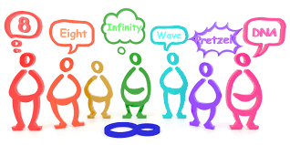
Why should I care?
Diversity of thought fosters creativity, innovation, and transformation. It is literally how research happens.
Same old thoughts = Same old ideas = No innovation

Slide 7
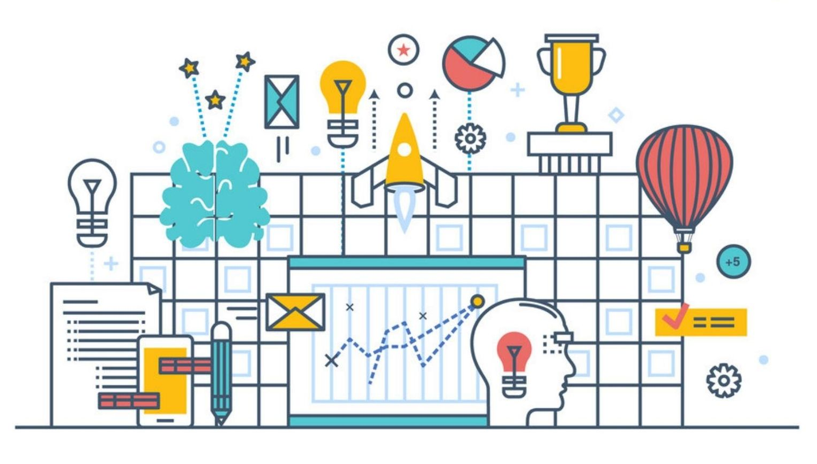
Section One: Why Research Administrators?

Slide 8
Sponsor Expectations
Plan for Enhancing Diverse Perspectives (PEDP) – A summary of actionable strategies to advance the scientific merit of the proposed project through diverse perspectives. [NIH]
Diversity Supplements Program (DSP) – Designed to facilitate the recruitment and training of promising scientists from diverse backgrounds (e.g., individuals from groups underrepresented in the biomedical research workforce). [NIH]
Broadening Participation in STEM (BP) – A commitment to expand opportunities in STEM to people of all racial, ethnic, geographic and socioeconomic backgrounds, sexual orientations, gender identities and to persons with disabilities. [NSF]
NonFederal initiatives – Familiarize yourself with sponsor expectations.

Slide 9
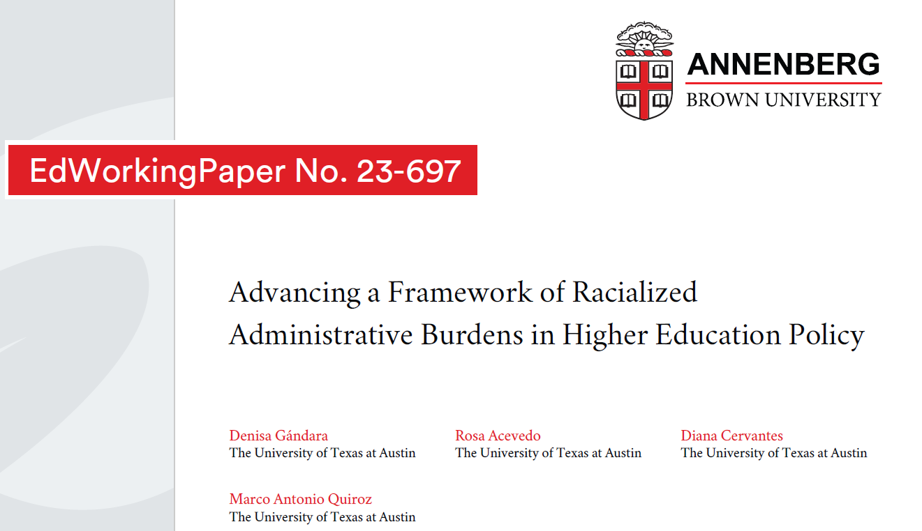
Racialized Administrative Burdens

Slide 10
Administrative Burdens
Three types of administrative burdens (Herd & Moynihan, 2018)
  Learning costs – burdens associated with understanding a policy and determining eligibility
  Compliance costs – the steps that one must take to access and maintain benefits of policy
  Psychological costs – emotional burdens associated with pressures of understanding policy, applying for, and maintaining benefits
Example: FEMA relief funding

Slide 11
How Administrative Burdens are Racialized
Complexity of requirements associated with racialized identity of recipients (ex. Social Security)
Whiteness as a credential (ex. white immigrants vs non-white immigrants)
Decoupling of rules for certain groups (ex. Black students in a classroom with a white teacher are less often assigned to gifted rooms regardless of preparation, also white students more often ask for exceptions)

Slide 12
In Research Administration
Research participants
Subrecipients

Slide 13

Section Two: Definitions

Slide 14
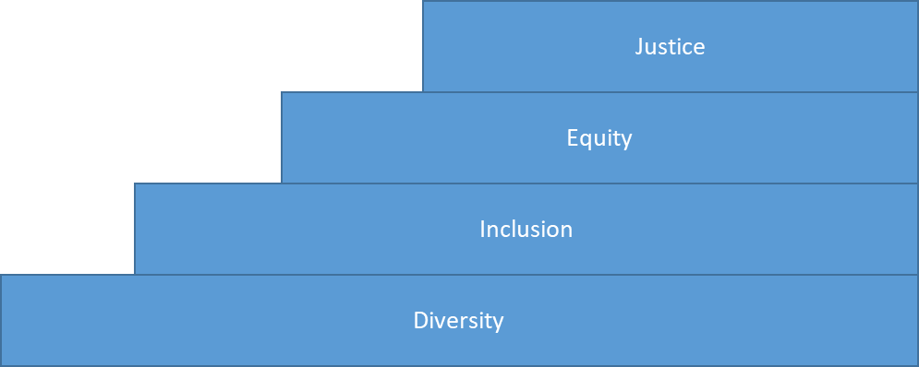
What is DEI/JDEI/DEIJ?
Notes:
Lots of names, always changing, based on preference . . . But same idea. Talk about how it’s a moving staircase
Diversity: different types of people
Inclusion: the different types of people are welcome
Equity: the different types of people are able to contribute equally
Justice: systems are in place by those in power to enable and acknowledge diversity, inclusion, equity

Slide 15
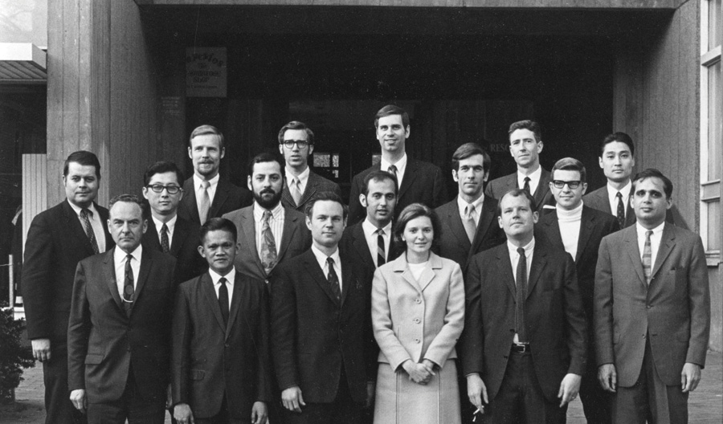

Which group is more diverse?

Slide 16
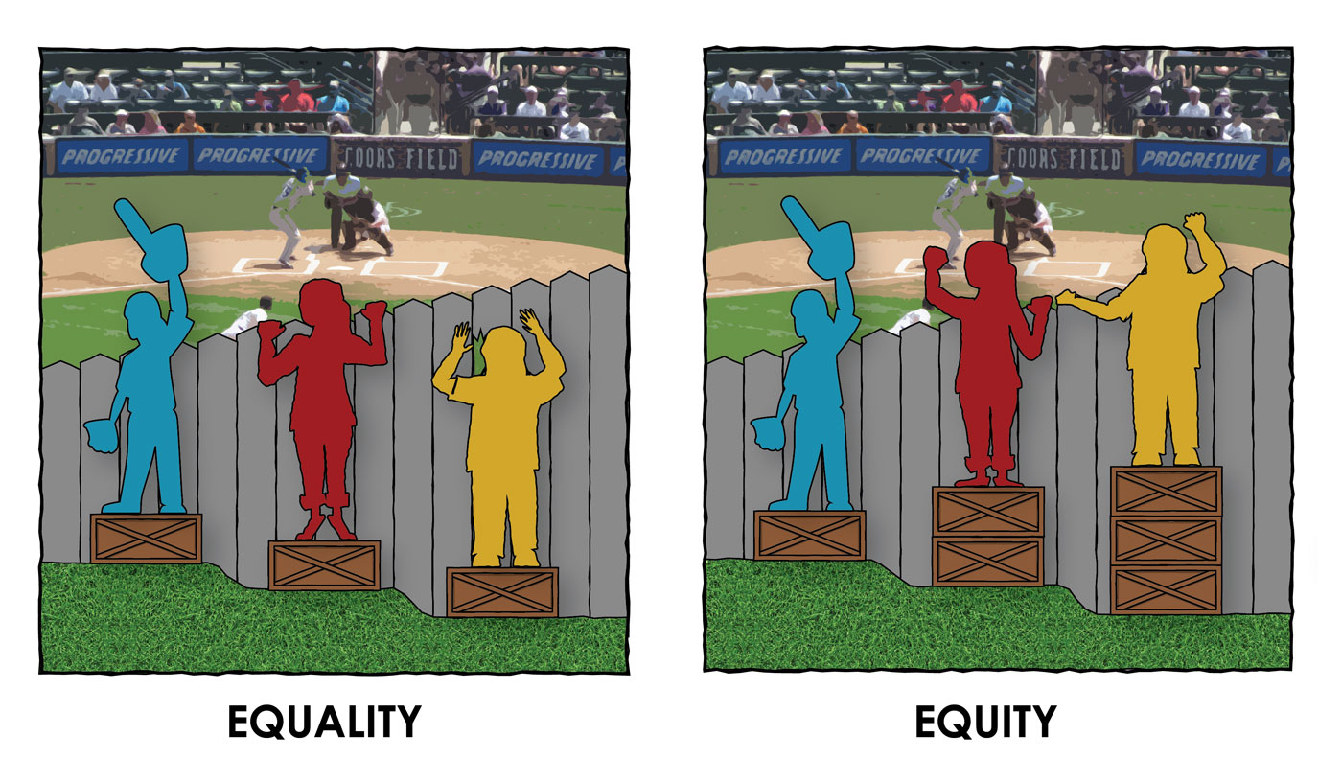
Equality vs. Equity
Source: https://ces101fall2018.wordpress.com/2018/09/10/equity-versus-equality-triple-participation/; Paul Kuttner

Slide 17
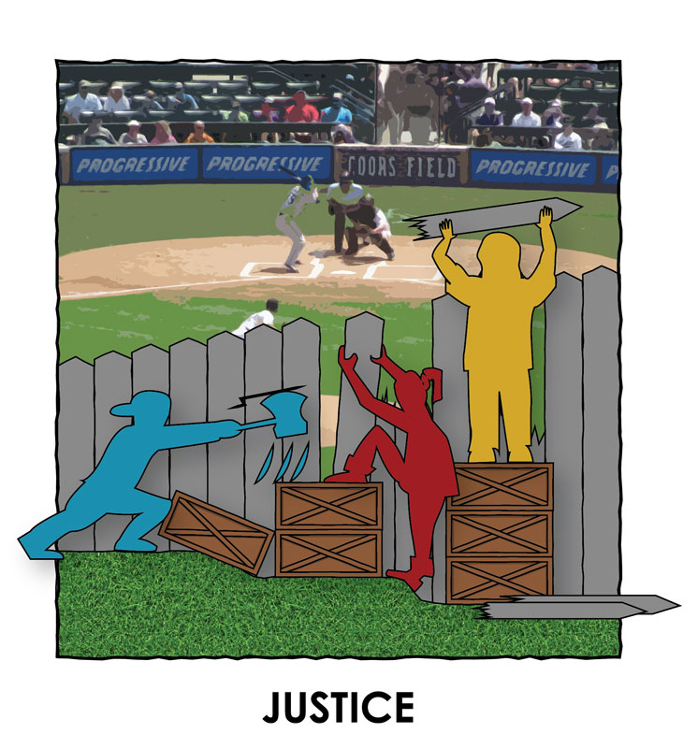



Justice and Liberation!
LIBERATION

Slide 18
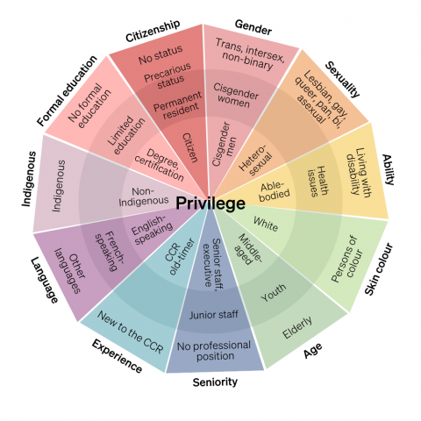
Intersectionality
Notes:
Think about your identities—how do they inform what you do, how you interact in groups? How do they relate to what people think say and do for you or to you?
In some situations, your identity might give you priviledge—me talking in a meeting of undergrads.
In some, they might give you a disadvantage or push you to the sidelines—me in a room of older white men with no kids talking about daycare.

Slide 19

Section Two: Stumbling Blocks
Section Three: Stumbling Blocks

Slide 20
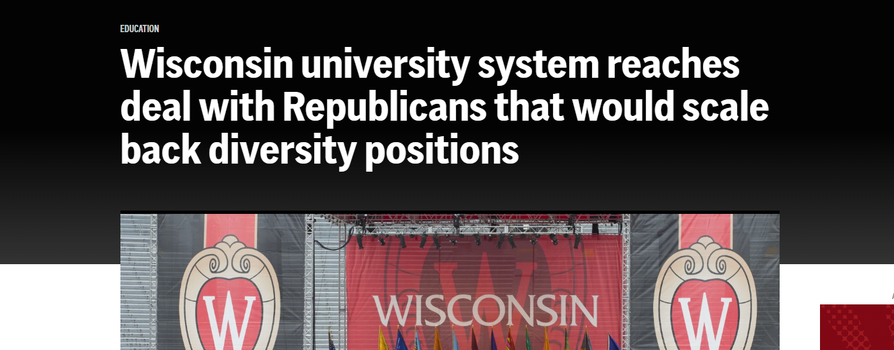

DEI in the UW Systems
Board of Regents Decision 2024
Info
Constitutional Amendment 4/2024
“Merit, Fairness, and Equality”
Info
Notes:
-Agreement from the Board to release raises
Freeze hiring
Move 43 DEI positions to “student success”
End affirmative action hiring program
Add endowed chair to focus on conservative political thought
-State Constitutional Amendment (moving forward)
Proposing hiring be focused on merit, fairness and equality

Slide 21
What gets in the way?
Bias
Hierarchy
Systems in place to favor certain individuals or groups (ex, “traditional” students)
Broken pipelines
Deadlines and schedules not modified to real life
Lack of understanding
Lack of listening or accepting other opinions
Acceptance of status quo (ex, “that’s how we do it here”
Competition
Lack of understanding how DEI fits into workplace
Stereotyping
Microaggressions

Slide 22
Who has the power? It depends!
Post-doc
Grad Student
College Staff (HR, Finance)
Sponsor
PI
Division Chair
Subaward Staff
Administrator
Central administration
Notes:
How does hierarchy work in our world? How does it play into intersectionality?
Situations:
-Project kickoff meeting with PI, co-Is, staff, students
-TA lunch and learn with undergrads (the TA is imbued with the power of the PI)
-

Slide 23
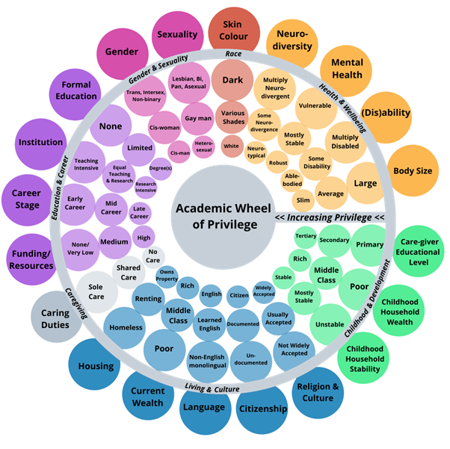
Notes:
How does hierarchy work in our world? How does it play into intersectionality?
Situations:
-Project kickoff meeting with PI, co-Is, staff, students
-TA lunch and learn with undergrads (the TA is imbued with the power of the PI)

Slide 24
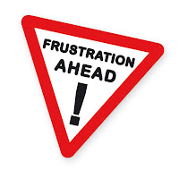
Intersectional Research Identities
Michelle is the PI of the project. She’s Afro-Latina, and a first-generation college grad from UW Madison. Tim was her mentor, but this is her third PI’d grant.
Tim is a Co-I. He’s white with a Harvard degree. He’s got 1% effort on this project.
Michelle is annoyed—when the meeting kicks off, or a question is asked, everyone looks to Tim!

Slide 25
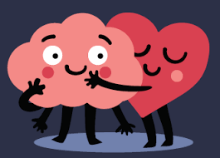
Section Three: So . . . What Do I Do?
Section Four: Solutions

Slide 26
Please download and install the Slido app on all computers you use
How empowered do you currently feel to intervene when you see a stumbling block?
ⓘ Start presenting to display the poll results on this slide.

Slide 27

1. Set the Ground Rules
What’s our goal here? What will we walk away from this with?
“Attack the idea, not the speaker”
Culture of respect and listening
Include Ouch statements or another form of respectful accountability
Include speaking limits or a method for allowing all space to speak
Consider a mission statement or goal statement for the meeting

Slide 28
2. Confronting Bias
Be conscious of your own potential privilege, whether it is defined by race, ethnicity, gender, age, sexual orientation, physical ability, etc. These are things you can count on not having to contend with in a negative fashion, in your day-to-day functions.
Remember that unconscious bias is not just defined by individual acts and behaviors. They can also be an invisible system that confers dominance and preference on a group.
Acknowledging your privilege is not about feeling guilty or rejecting one's heritage or roots. It is about choosing to use your privilege to help others who unjustly bear burdens you do not.
Raise awareness of unconscious assumptions and
their influences on others.

Slide 29
2. Confronting Bias cont.
Whether for hiring staff, grant applications, or other occasions, for increased perceived variability, try to attain an increase in the proportion of applicants/participants that are from underrepresented groups (e.g. women, under-represented minorities, etc.).
Focus on skills rather than on traits.
Develop and prioritize criteria prior to evaluating applicants or participants.
Spend sufficient time and attention on evaluating each applicant or participant.
Use inclusion instead of exclusion decision-making processes.
Hold yourself and other members of committees, work groups, etc., responsible for not only selecting excellent staff, applicants, etc., but also for conducting fair and equitable evaluations.

Slide 30
3. What do I say?
If you see something, say something—BUT SPEAK FOR YOURSELF.
You might not have intended it to sound like this, but I heard . . .
I think that’s a stereotype.
I heard you say xxx; could you clarify that?
That’s not true.
Why is that funny?
What you said was hurtful to me.
Yeah, it’s not cool to say XYZ. Say ABC instead.
Ouch!
Notes:
Don’t say “I think Eduardo was offended by that joke about immigrants.” Speak for yourself.
Examples:
-Well, women are better at organizing; can you schedule that?
-You sound so eloquent/well spoken!
-What do Black people think about that issue?
-I don’t work with faculty from China, I can’t understand them
-Racist or sexist jokes

Slide 31
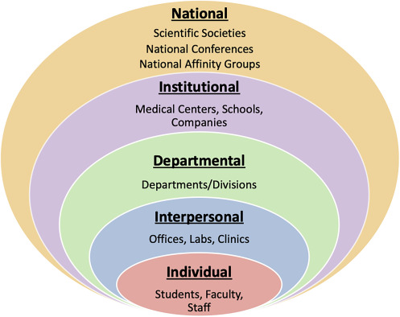
4. Tell power to promote diversity
If you see something, say something, part 2.
“Have you noticed that only the tenured professors speak at our department meetings?”
“Did you see that only 5 people attended the LGBTQIA+ alliance talk? Could we think of different ways to promote that next time?”
“Someone expressed frustration to me with the tenure process. I was thinking, do we offer some form of acknowledgement for JDEI or community work for tenure consideration?”
“Could we offer childcare at that 7 pm workshop so more people with kids could come?”
Notes:
Levels at which things change—individuals can make change, but remember Justice is where the real institutional transformation happens

Slide 32
5. When You Mess Up
Shut up and listen
1
Acknowledge and make sure you understood
2
Apologize, if needed
3
Do the work, and do better next time
4
Notes:
2. “What I heard you say is, you were hurt when I made that comment about women in science. Did I understand that correctly?”
3. Remember preschool: “I’m really sorry” is better than “I’m sorry what I said hurt your feelings,” cause the onus is placed on them. Keep it short and simple, and DON’T BRING IT UP AGAIN.
4. Sit with yourself, journal, learn. The real apology is in changed behavior, not in words.

Slide 33




Remember: JDEI is Alive!
Justice
Equity
Inclusion
Diversity
Notes:
-JDEI work is constant and continuing. You will make a mistake, you will have to go back to basics. Use your resources and your groups to continue the work.

Slide 34
There’s no finish line… there’s only the journey.
Change yourself, change the world.
Notes:
JDEI is not solo work, and it’s not done in a vacuum.

Slide 35


